Slide 1
Handwriting Number Recognition
Hanyi Zhang, Linqiao Shang, Xin Li

Slide 2
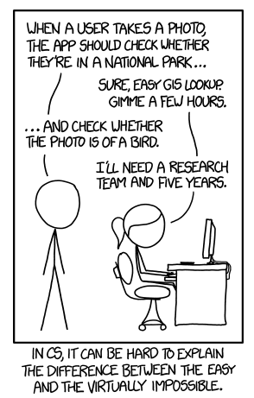
Introduction
Picture Recognition is a hot topic these years due to the development of Machine Learning and Artificial Intelligence.
It’s an easy task for human to read handwritten words and digits. But it take much more time for machines to decide.
We start with digits recognition due to its less outputs and symbol for words.

Slide 3
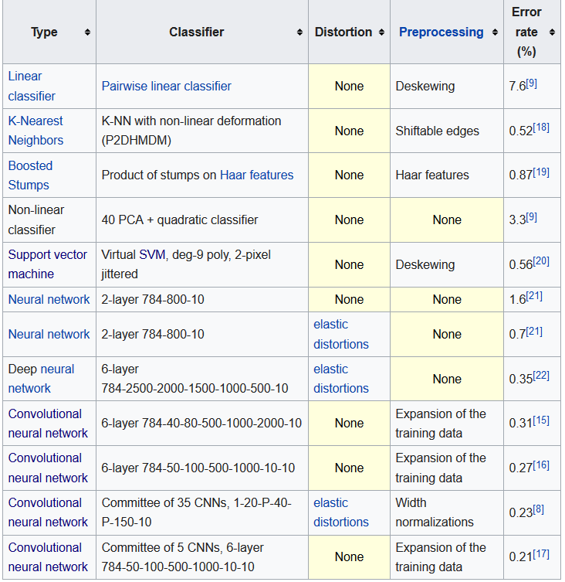
Related Works
In 1998, a best-case error rate of 0.42 percent was achieved on the database by researchers using a new classifier called the Gradient-Based Learning.
In 2016, an error rate of 0.21 percent, improving on the previous best result, was reported by researchers using a method called convolutional neural networks

Slide 4
MNIST database
The MNIST problem is a dataset developed by Yann LeCun, Corinna Cortes and Christopher Burges for evaluating machine learning models on the handwritten digit classification problem.
The dataset was constructed from a number of scanned document dataset available from the National Institute of Standards and Technolgy (NIST). This is where the name for the dataset comes from, as the Modified NIST or MNIST dataset.
Each image is a 28 by 28 pixel square (784 pixels total). A standard spit of the dataset is used to evaluate and compare models, where 60,000 images are used to train a model and a separate set of 10,000 images are used to test it.

Slide 5
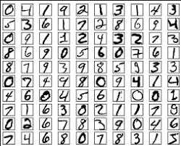
MNIST database
Images of digits were taken from a variety of scanned documents, normalized in size and centered. This makes it an excellent dataset for evaluating models, allowing the developer to focus on the machine learning with very little data cleaning or preparation required.
It is a digit recognition task. As such there are 10 digits (0 to 9) or 10 classes to predict.

Slide 6
Neural Network Solution

Slide 7
Convolution Neural Network Solution

Slide 8
Comparison

Slide 9
Conclusions and Improvements
We can use deep learning method, introducing much deeper (and larger) networks to be trained. Like adding more hidden layers.
If time is curtail to a training process. Less layers or even less inputs can be applied to learning.
Parameters can be tuned to improve the training. And Epochs can be applied more times to ensure the accuracy.

